Slide 1

🌾 Crop Production Prediction
Using Machine Learning & Streamlit Dashboard

Slide 2

Problem Statement
Agriculture serves as a cornerstone of global economic stability, yet production forecasting remains challenging. Our goal is to predict crop production (in tons) using key agricultural factors:
Area harvested (hectares)
Yield per hectare (kg/ha)
Temporal trends by year
This predictive capability enables proactive decision-making for food security, evidence-based policy development, and strategic supply chain optimization.

Slide 3



Business Use Cases
Food Security
Policy Development
Supply Chain
Forecast production levels to prevent shortages and ensure stable food supplies across regions.
Support evidence-based subsidies, insurance schemes, and agricultural regulations.
Optimize storage capacity, transportation routes, and distribution networks.
Market Forecasting
Precision Farming
Agri-Tech Innovation
Predict price trends and market fluctuations to guide investment decisions.
Guide farmers in optimal resource allocation for maximum yield efficiency.
Enable development of smart farming applications and decision-support tools.

Slide 4

Dataset - FAOSTAT
📊 Data Source: FAOSTAT
Comprehensive global agricultural database providing multi-year, multi-region crop production statistics.
Key Variables:
Area - Geographic regions and countries
Item - Specific crop types
Year - Temporal data points
Area harvested - Land usage (hectares)
Yield - Production efficiency (kg/ha)
Production - Total output (tons)

Slide 5
Methodology Approach
01
02
Data Cleaning & Preprocessing
Exploratory Data Analysis (EDA)
Handle missing values, normalize data formats, and reshape datasets for optimal model input. Quality assurance ensures reliable predictions.
Analyze crop distribution patterns, identify temporal trends, and conduct comprehensive correlation analysis across variables.
03
04
Model Development & Training
Interactive Dashboard Creation
Implement multiple algorithms including Linear Regression, Random Forest, and XGBoost. Evaluate performance using R², MAE, and MSE metrics.
Develop Streamlit-based interface for real-time EDA exploration, model results visualization, and production predictions.

Slide 6
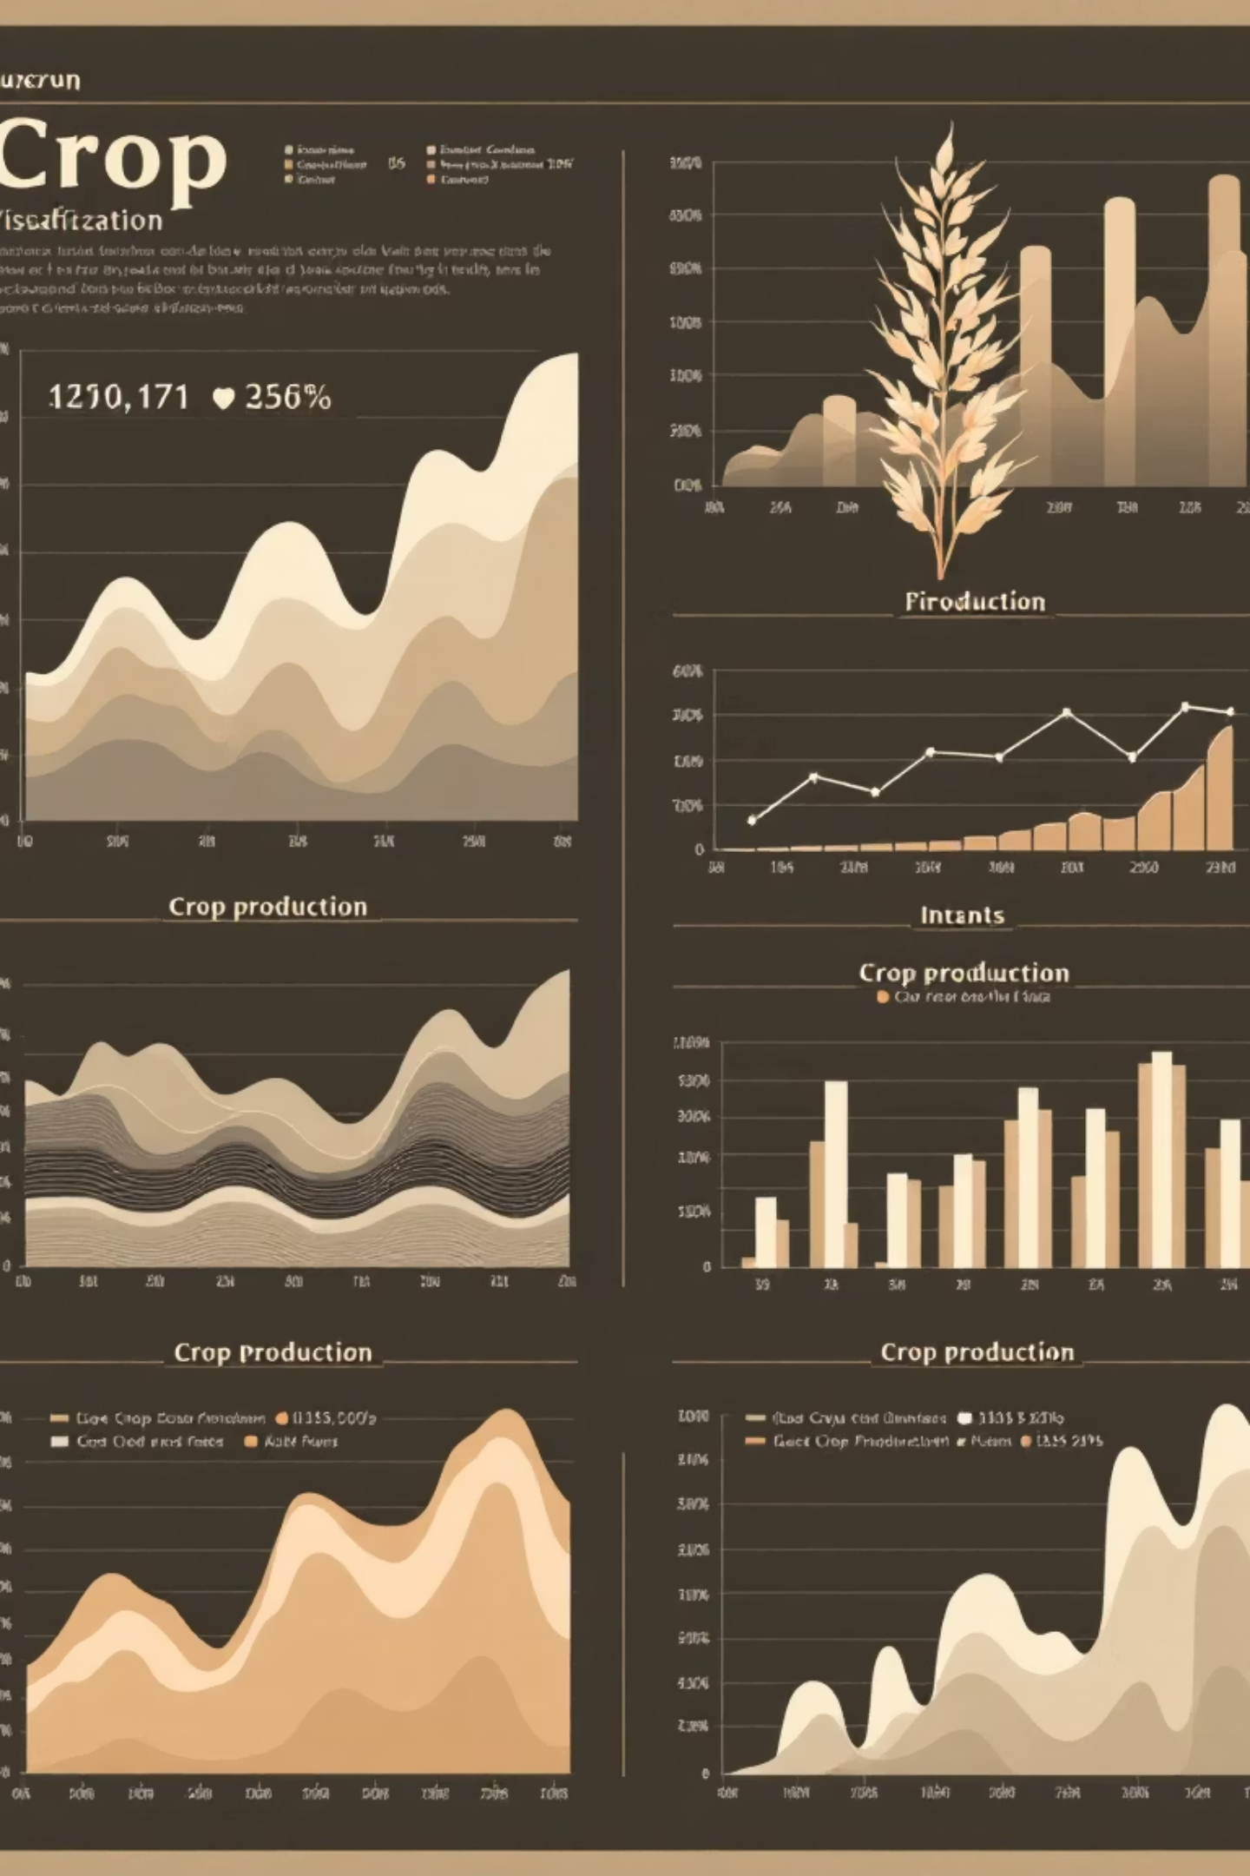
Exploratory Data Analysis Insights
Crop Diversity Analysis
Identified top 10 most cultivated crops globally, revealing agricultural priorities and regional specializations across different markets.
Temporal Trend Patterns
Observed significant production trends across multiple years, highlighting seasonal variations and long-term agricultural evolution.
Variable Correlation Mapping
Discovered strong positive correlation between area harvested and production output. Utilized heatmaps for comprehensive relationship visualization.

Slide 7
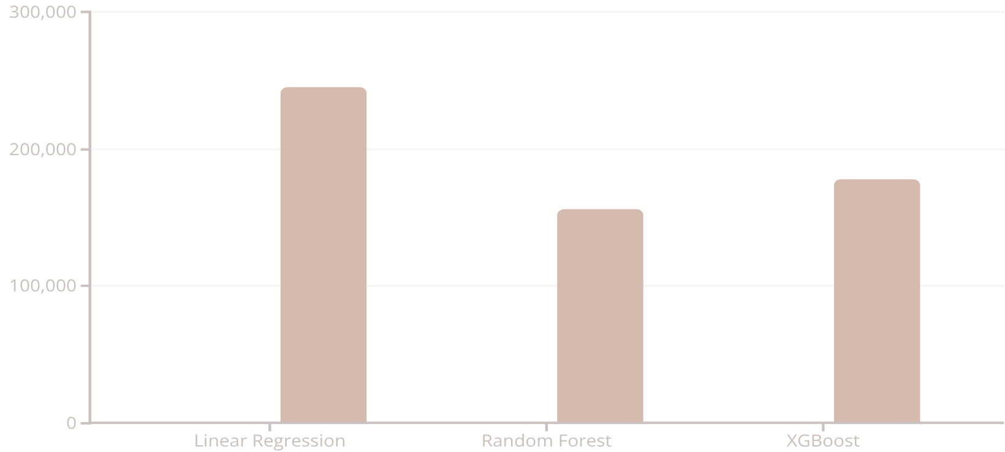

Model Performance Comparison
📈 Algorithm Performance
Comprehensive evaluation across three machine learning approaches using standard regression metrics.
Winner: Random Forest - Achieved optimal balance of accuracy (R² = 0.92) and model interpretability, making it ideal for agricultural stakeholder communication.
R² Score
MAE
Evaluation metrics included R-squared, Mean Absolute Error (MAE), and Mean Squared Error (MSE) for robust model comparison.

Slide 8

Interactive Streamlit Dashboard
🎨 Clean Interactive UI
📊 Multi-Module Navigation
🔮 Real-time Predictions
User-friendly interface designed for both technical and non-technical stakeholders in agricultural decision-making processes.
Intuitive sidebar navigation allowing users to seamlessly switch between EDA exploration, model performance analysis, and production predictions.
Interactive prediction interface where users input area, crop type, and year parameters to receive instant production forecasts with confidence intervals.

Slide 9
Key Outcomes & Impact
✔ Enhanced Agricultural Intelligence
✔ Interactive Decision Support
Developed comprehensive understanding of global agricultural production trends, seasonal patterns, and regional variations for strategic planning.
Created accessible tool enabling stakeholders to explore complex crop data relationships and generate insights without technical expertise.
✔ Predictive Planning Capability
✔ Multi-Stakeholder Value
Established reliable forecasting framework supporting proactive decision-making for future agricultural seasons and policy development.
Delivered actionable insights benefiting farmers, policymakers, and agribusiness professionals across the entire value chain.

Slide 10

🙏 Thank You
Questions?
Ready to discuss implementation strategies, technical details, or explore additional agricultural forecasting opportunities

